Slide 1
Quick Overview of RDBMS’s
Breitzman
1/16/2018

Slide 2
Intro: Quick Demos
You will recall from first night and syllabus that each of you will present 1 to 5 quick demos (5 minutes or so)
The reason is we don’t have the time to do a full-semester capstone project
Another reason is it’s good to learn from your peers
A final reason is no one wants to hear me lecture for 2 hours twice a week
The topics can be anything from a short demo of a tool that’s cool and useful, or a visualization or modeling technique that is easily explained and will be useful to the class.
An example might be a demo of Microsoft Power BI, or PyPlot or matplotlib etc.

Slide 3
Intro: Quick Demos (II)
The following contains actually 4 related demos:
  MS Access
  SQLite
  Integrating Python and SQLite
  SQLiteStudio

Slide 4
Last year I moderated a panel of people from companies that hire a lot of Data Analysts
I asked what the three most important technical skills they were looking for in potential data analysts
Any ideas what they are?

Slide 5
Last year I moderated a panel of people from companies that hire a lot of Data Analysts
I asked what the three most important technical skills they were looking for in potential data analysts
  SQL
  Python
  R
We’re going to do a lot with Python and R in this course.
In the next 30 minutes I’ll give a very quick overview on what you can do with SQL

Slide 6
Big Data/Projects etc.
The other reason to do a crash course on databases is that you may run into data sets that are quite large and storing them in a RDBMS is a good idea
It’s also good to have an idea of how you might store and query a large data set
You still should take a database course at some point, but this overview will give you an idea of what is possible…

Slide 7
MS Access
If you don’t know SQL you can still do interesting things with MS Access
Access uses a QBE (Query by Example) system, that allows you to generate complicated SQL without knowing SQL
Access is also widely available because it comes with Office professional. It can be freely downloaded with your Rowan login info

Slide 8
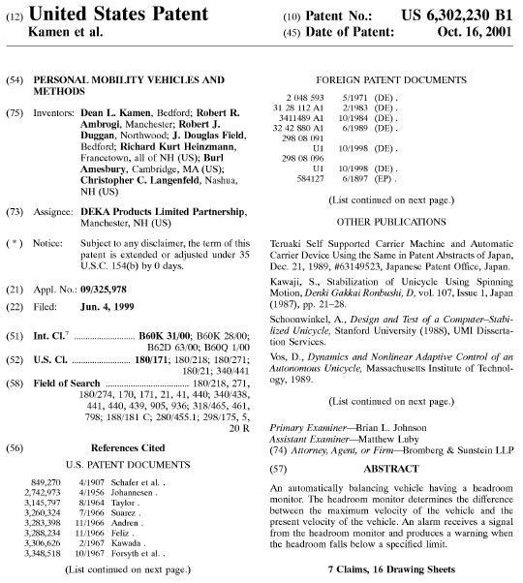

Front Page of a US Patent (Segway Patent)

Slide 9
A Typical Patent Front Page Has…
Patent #, Title, Abstract, Application Date, Issue Date (All one-to-one relationships)
Inventor(s) (one-to-many)
Assignee(s) (one-to-many)
International Patent Classes (one-to-many)
Cited References (one-to-many)
A Relational Database Management System (RDBMS) is an excellent tool to store patents because:
  There are millions of patents that can be stored in a main table, and each of the other tables (inventor, assignee, etc.) can be linked to the main table by patent number (primary key)

Slide 10
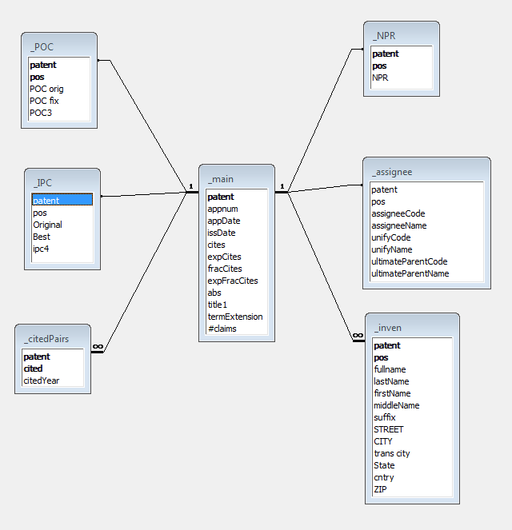
A Relational Patent Database
The infinities indicate one-to-many relationship
All tables joined on patent #
Main table has 6+ million rows, inventor has 15+ million, cited pairs has 90+ million etc.
If you have a lot of data with relationships a database is hard to beat
  Efficient storage
  Fast access
  Easy to query
  Easy to generate reports on subsets of data
∞
∞
∞
∞

Slide 11
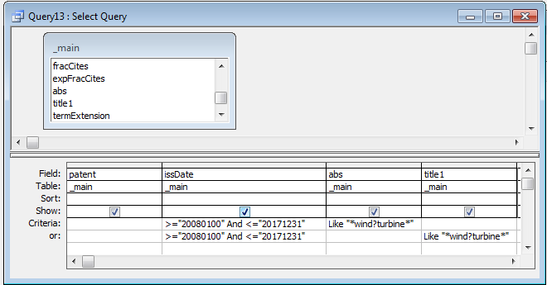
Access QBE (Query by Example) Example
This query identifies all patents that mention ‘wind-turbine’ or ‘wind turbine’ in the title or abstract for any patent issued between 2008 and 2017
The equivalent SQL is:
SELECT [_main].patent, [_main].issDate, [_main].abs, [_main].title1
FROM _main
WHERE ((([_main].issDate)>="20080100" And ([_main].issDate)<="20171231") AND (([_main].abs) Like "*wind?turbine*"))
OR ((([_main].issDate)>="20080100" And ([_main].issDate)<="20171231") AND (([_main].title1) Like "*wind?turbine*"));

Slide 12
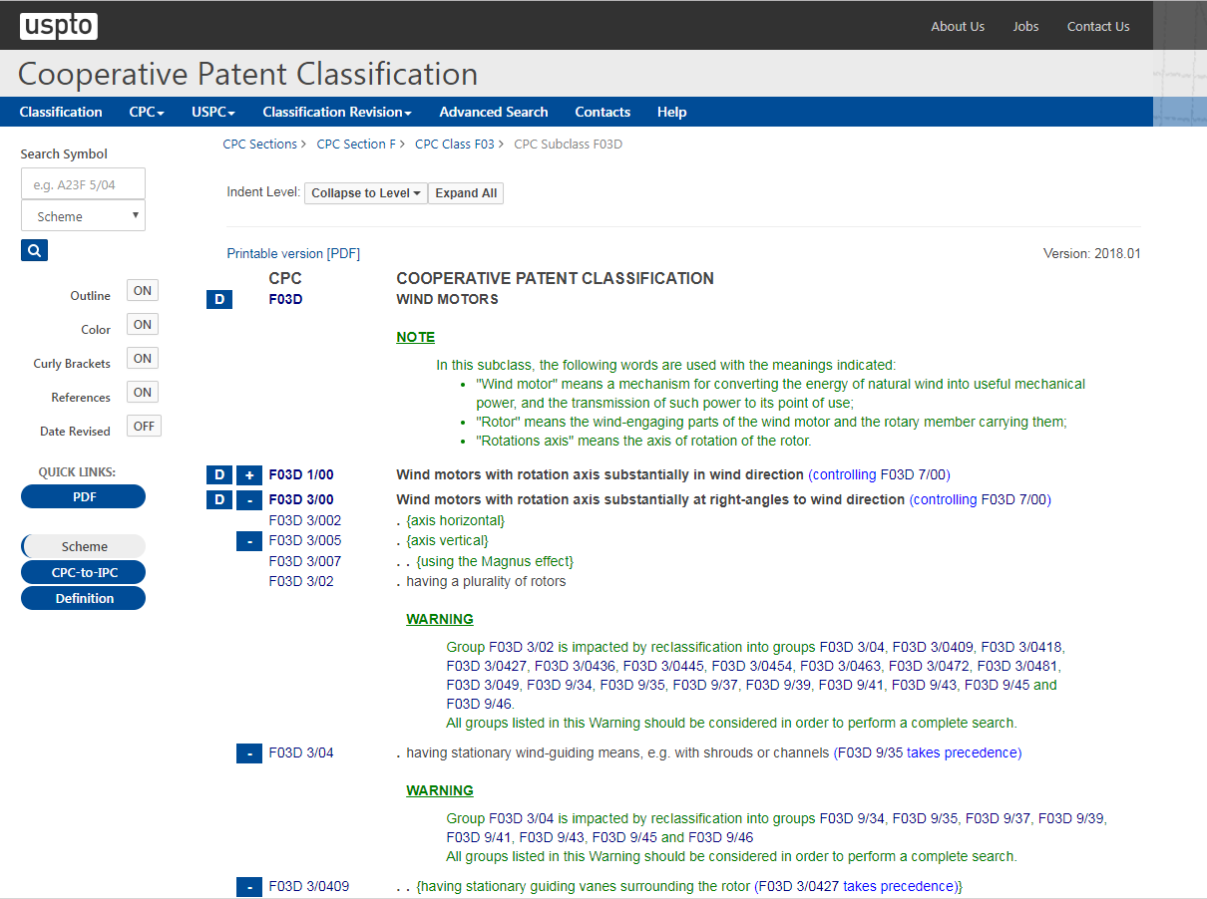
Patent Classification Example

Slide 13
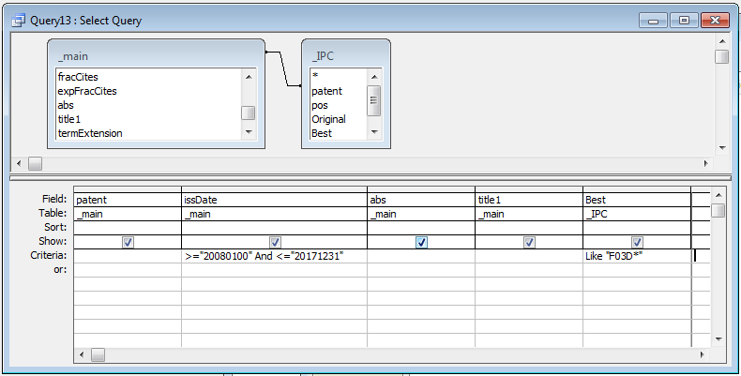
A Better Way to Get All Wind-Turbine Patents

Slide 14
This is not about patents…
The point is a database system is useful for storing lots of data
It is easy to get an interesting subset by querying and joining attributes of the various tables
For example, in the previous example it’s easy to get the following sets
  Patents that mention ‘database’ and are owned by ‘Oracle’
  # patents issued by year that mention ‘nanotechnology’
  The number of inventors with Canadian addresses that have co-inventors from the US
  The top inventor for ‘Lockheed Martin’
  Etc.

Slide 15
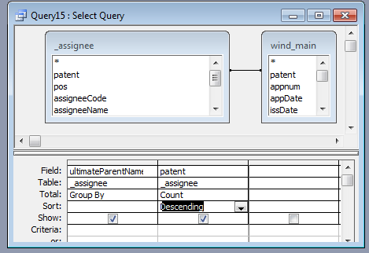
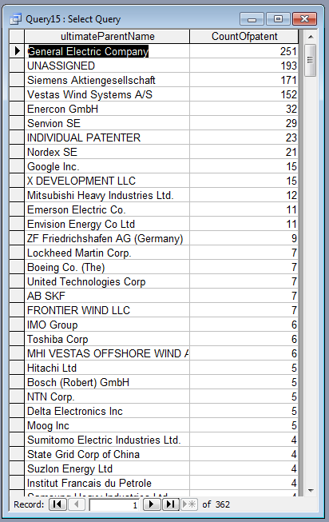
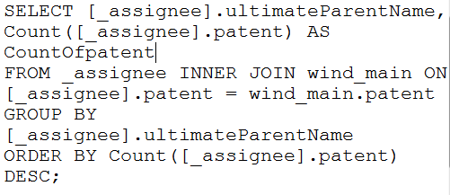
A Couple of Quick Examples with MS Acces
(Example 1: Top Wind Turbine Companies)

Slide 16
Example 2: Build Report Showing Google Wind Energy Patents
Open Database
Show Google Query
Run Report Wizard
Modify Header
Set Title to Can Grow
Show how to export to Word and Excel

Slide 17
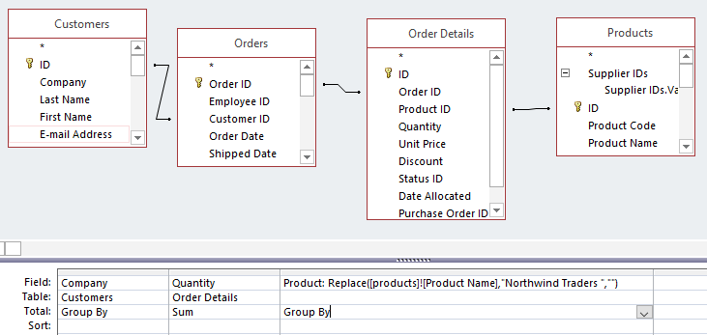
Example 3: Report with Pie Charts
Simple Query shows top products by customer

Slide 18
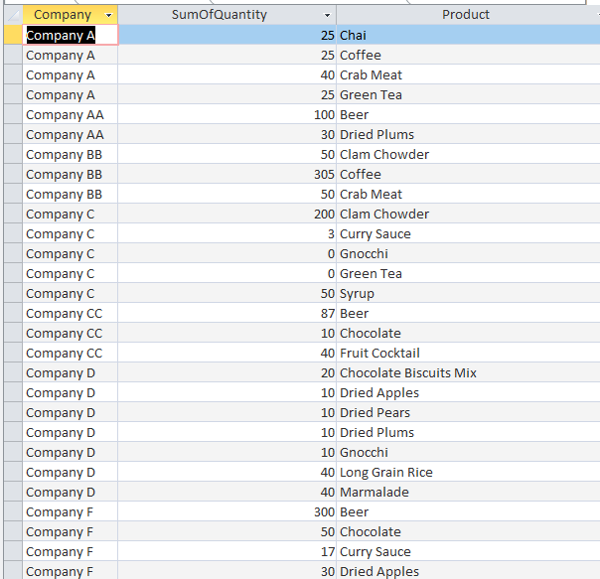
Output of Query that will become report

Slide 19
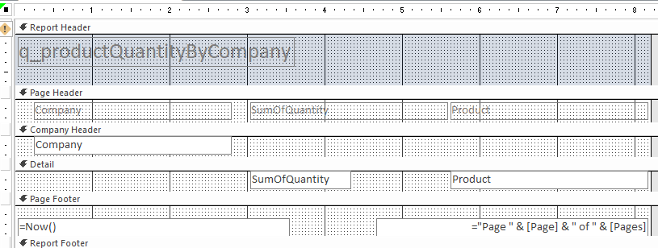
Report Design

Slide 20
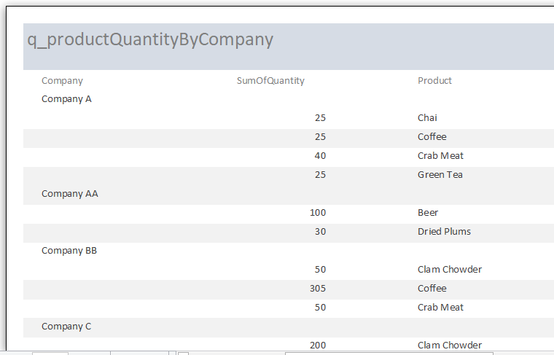
Report Output

Slide 21
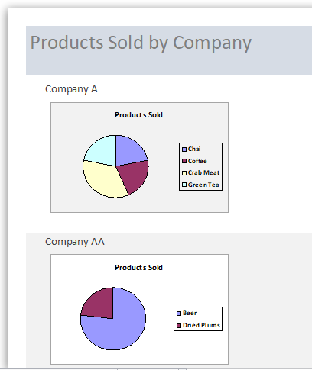
Report with Pie Charts

Slide 22
Report with Pie Charts (2)
Previous report was cut off, but has as many charts as customers
The significance of this, is if you need to make 100 similar charts that would take 2 weeks in Excel, you can do it in an Access report and generate 100 charts (or thousands) in 15 minutes

Slide 23
Microsoft Access Pros/Cons
Pros
  Has an excellent report generator
  Has a QBE implementation of SQL (can be used to learn SQL or develop elaborate SQL queries)
  Can be used to create quick data entry applications
  Uses VBA (just like other office products)
  Can be used to generate hundreds or thousands of charts (Excel can’t do that)
  Can be used as a front end for MySQL, MS SQL Server, SQLite, etc.
  Has macros, forms, triggers, indexes etc. (all the stuff you would expect)
  Can support multiple concurrent users
  Can import files from dozens of formats
Cons
  2 Gigabyte maximum DB size (can still create an infinite size DB via linked tables; also can link through to large SQLite or MySQL dbs)
  Can’t really support hundreds of users like SQL Server and others
  Some say the Jet database engine is less reliable then other engines
  Tends to be viewed as toy by most DBAs
  Stuck with VBA; can’t be accessed with Python, Java, C# etc

Slide 24
SQLite
SQLite is a database engine contained in a C library and callable from almost any high level language
It is not a client-server database so it is a popular database in embedded systems and with users that do not want to install or have the overhead and inconvenience of a database server.
It’s a standalone library which just gets linked into a compiled program. This is where the ‘Lite’ comes from; it’s considered a Lightweight installation of SQL.
As a result it is thought to be the most widely deployed database system (although there is really no way to confirm this)
According to Wikipedia: D. Richard Hipp designed SQLite in the spring of 2000 while working for General Dynamics on contract with the United States Navy. He was designing software used aboard guided missile destroyers, which originally used HP-UX with an IBM Informix database back-end.

Slide 25
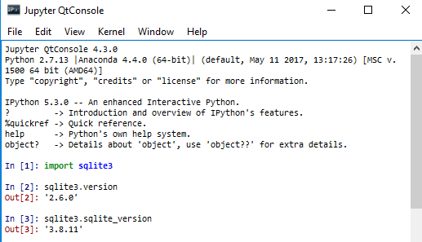
Invoking from Python
Use import like any other library (may need to install or update)
In this case we see we are using version 2.6.0 (This is the Python version of the library)
The SQLite version is 3.8.11 (If a new version of SQLite comes out, it won’t be in effect until someone updates the Python bindings)

Slide 26
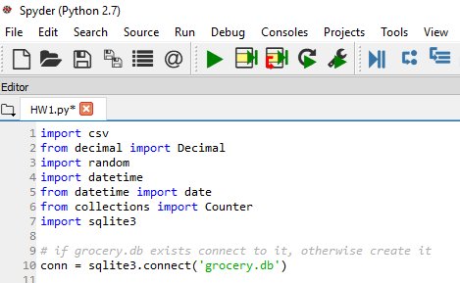
Creating a Database
Call sqlite3.connect with the name of the database you wish to create
If it already exists it will connect to it, if it doesn’t it will create it and connect to it.

Slide 27
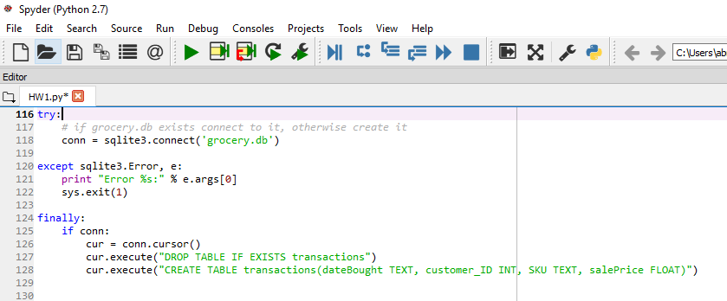
Adding a Table to the Database
Note the drop table if exists....
  This is a standard practice that allows you to modify and rerun the program without breaking things
  Note if you run the program a bunch of times the database can still get large with wasted space even though the old table is deleted (see vacuum several slides ahead)
We should actually check for sqlite errors on both of those executes!

Slide 28
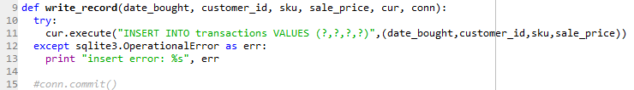
Writing to the Table
Note we can use any SQL statement inside the execute command
Notice the commit() has been commented out
We use commit() to tell SQLite to actually write the insertion to the database
If we do a commit() after every insertion it slows the program to a crawl.
Since we don’t have concurrent users we can do something like 50,000 transactions between commits, so I moved the commit to an outer for loop where it only occurs after several thousand transactions

Slide 29
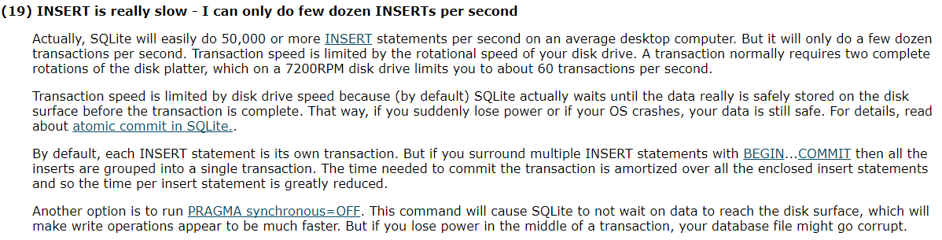
From the SQLite FAQ

Slide 30
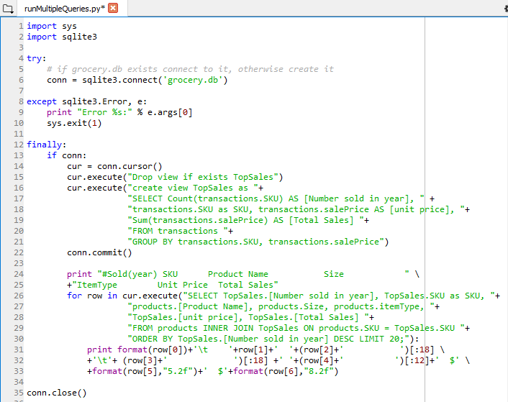
Assigning SQL Output to Python Variables

Slide 31
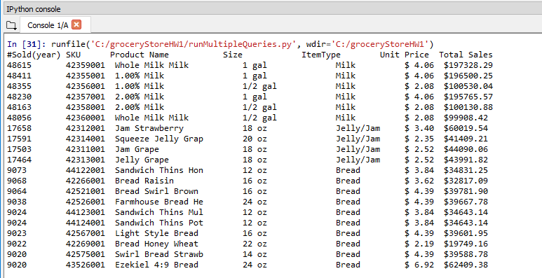
Output of Previous Program

Slide 32
SQLiteStudio (1)
Making the summary by having Python call the SQLite database is a bit of a pain
I only did it to show you that database output can be assigned to variables in Python (which is useful for many things)
In general, it’s more flexible to use an RDBMS to do the summary
SQLiteStudio is a useful front end for an SQLite database
You could also use Access (although it doesn’t like large files)

Slide 33
SQLiteStudio (2)
SQLite has implementations in other languages like Java, C++, C# etc. But it need not be called from a programming language
SQLiteStudio is a standalone SQL database manager for windows (I’m sure there is something similar for Macs)
It’s lightweight also. It doesn’t need to be installed; doesn’t change the registry.
In SQLite you can run queries, import and export tables, create and delete tables, add indexes etc.
You can also check column names and types, add new columns etc.

Slide 34
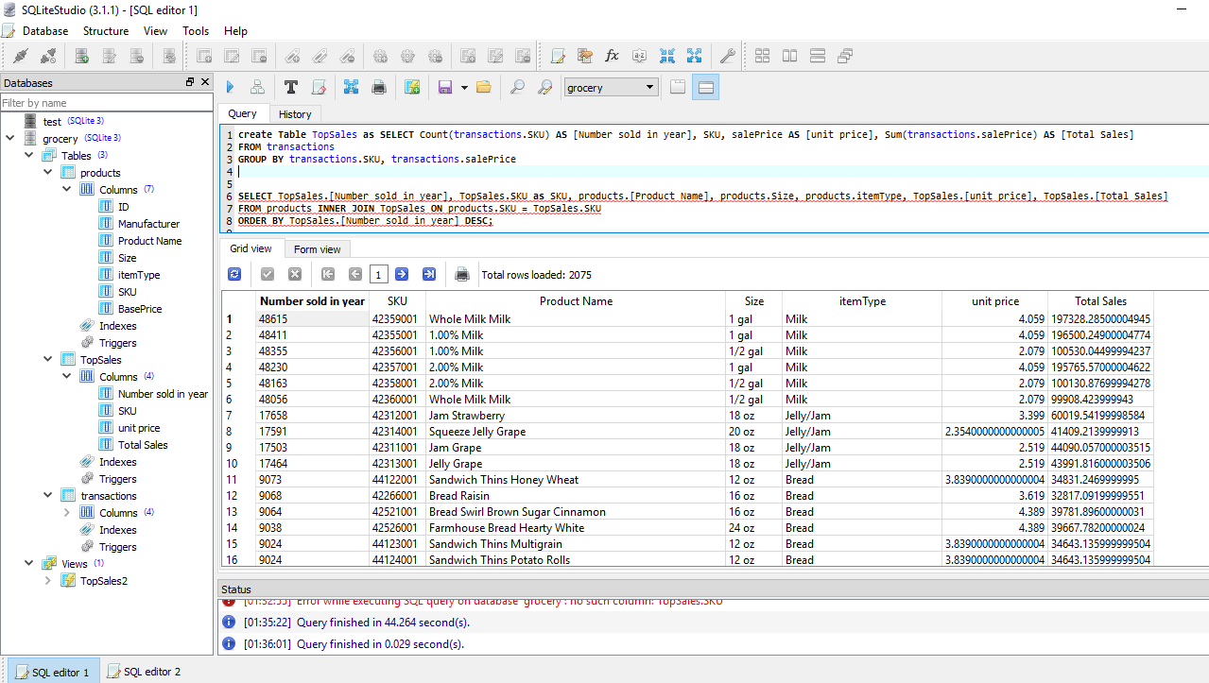
Same Output Using SQLite Query Editor

Slide 35
Why use Temp Table?
Note we used a view in the Python implementation and a temporary table in the SQLiteStudio version
Both took roughly 45 seconds (The table is good if you are going to reuse it multiple times because unless the view is cached it will cost you 45 seconds each time it’s used)
The second query that uses the view or temp table runs in less than a second
It’s tempting to try to do the job in a single query so we don’t need a view or temp table but that is costly…

Slide 36
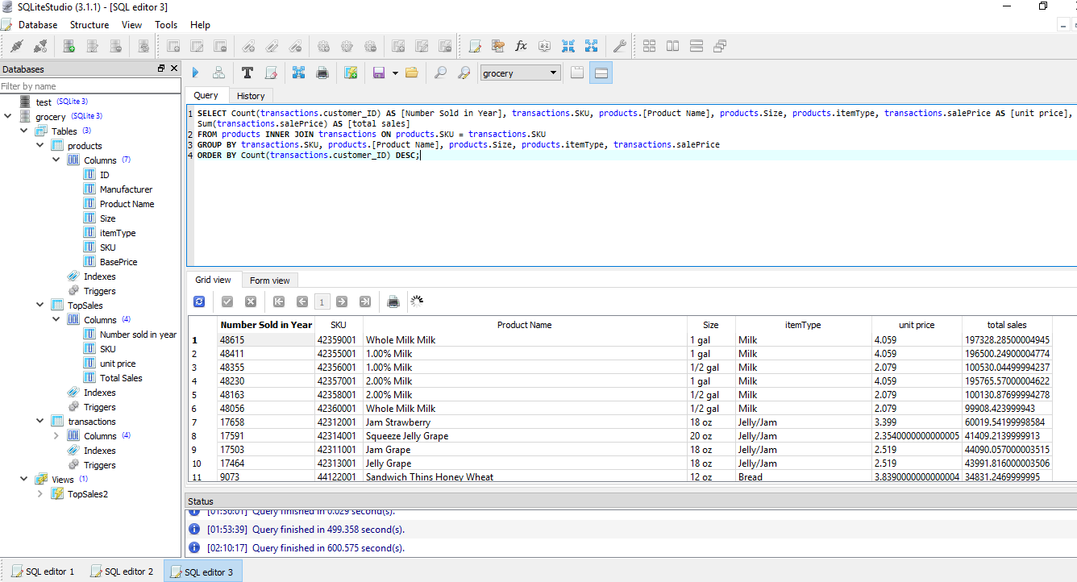
Same Output Using No Temp Table

Slide 37
Notes on Previous Slide
The single query approach gives the same output but takes 600 seconds instead of 45. Why?
Joins involving large tables are expensive.
  By creating the intermediate table (or view) we end up joining 2 tables with 2076 rows instead of 1 table with 11 million rows and 1 with 2076
Aggregating is cheaper than joining.
  The temp table is just a 2076 row aggregation of the 11 million row table
But shouldn’t the query optimizer have figured that out?

Slide 38
Why the Query Optimizer Failed
I don’t want to get into a whole big thing. We’re trying to compress a 15 week database course into a half-hour, but here’s a short answer
Joins are expensive. Joining 2 tables essentially involves 2 for loops with each the size of it’s respective table so that leads to 11 million * 2000 comparisons
A query optimizer can optimize when multiple joins are involved if reordering the joins can lead to smaller intermediate results but in this case, the query optimizer attempts the join and then aggregates. It’s not going to be obvious to the query optimizer to aggregate first

Slide 39
MS Access and SQLite
Access makes a nice database frontend for other databases
With the SQLite ODBC driver for Access
(available here: http://www.ch-werner.de/sqliteodbc/ ) performance can be improved
You will recall that the maximum size of an Access database is 2 gigabytes and that it uses a the jet database which is not great
The maximum size of an SQLite database is 140 terabytes and it is very fast

Slide 40
MS Access and SQLite (2)
The advantage of MS Access is complicated queries can be built visually
Note the query to produce the summary table for the grocery store shown in slide12 takes the same 45 seconds to run with Access as a front-end to the ODBC connected SQLite database
If instead of using SQLite we import the transaction table into Access, the query takes 71 seconds using the Jet database and we get close to the 2 gigabyte size limit
Connecting through ODBC, the Access database file grows to only 912 kilobytes after creating the temp table and summary table.

Slide 41
Other Options
Other open source options: Postgres and mySQL
  Both free. mySQL is owned by Oracle so it is assumed that it will eventually be allowed to wither away
  Postgres used to be really slow. I’m told it’s faster now but I haven’t tried it in years
Best selling RDBMS is Oracle. It’s expensive, but there is a full featured community version that is free provided you keep your database smaller than 9 Gigs
MS SQL Server is also expensive, but it’s community version is free as well, with a limit of 10 Gigs
Teradata Aster is a distributed database whose free version is limited to 17 Gigs

Slide 42
Languages
SQLite and mySQL can be used with numerous languages: Python, C/C++, C#, Java etc.
MS Access is restricted to Visual Basic
MS SQL Server is married to the .Net system so that’s C/C++/C#, Visual Basic, although I think there is a .Net library for Java
Oracle is good with C/C++, Java, Python
PostgreSQL is accessible to most, but there are some weird rules about trusted and untrusted languages…

Slide 43
Conclusions
At some point take a database course. It’s useful
If you’ve never had a database course, this is like brief tour that will give you an idea of what you can do with an RDBMS
Best way to learn is by doing, so if you’ve never used SQL, try to store a large dataset in SQLite or mySQL and see if you can read and write to it from your language of choice.
I tested this a couple of weeks ago. You can store 1 million records in an SQLite database using Python on an I3 in about 20 minutes.

